Slide 1
Thinking Computationally
Charles Severance
University of Michigan
School of Information

Slide 2
T E C H
P
R
O
S
EVERYONE
ELSE
N
O
N
T E C H
Notes:
Questions: Who in this room makes their living as a professional programmer or system adinistrator – 8 hours per day? How many people have good-paying jobs where you never touch or use technology?

Slide 3
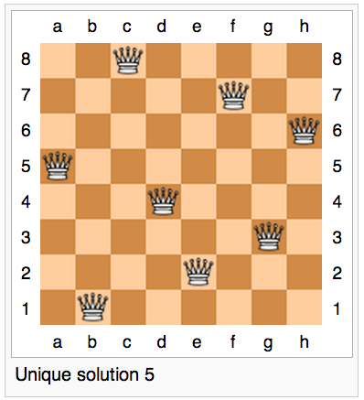
http://en.wikipedia.org/wiki/Eight_queens_puzzle
Notes:
We make the mistake far too often to equate computational thinking with “Introduction to Computer Science”. In high school we would call this “AP Computer Science”. Should we just force everyone to take AP Computer Science to solve this 21st century problem?

Slide 4
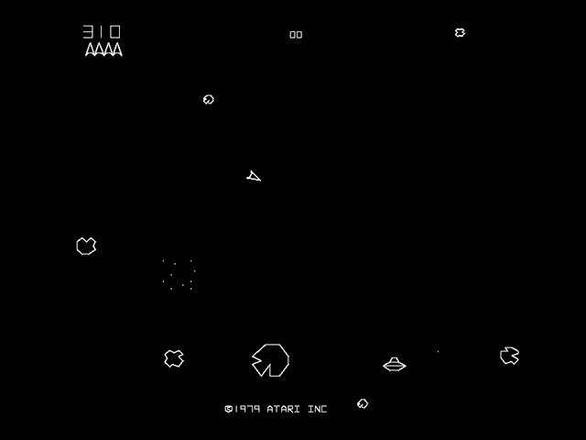
http://en.wikipedia.org/wiki/Asteroids_(video_game)

Slide 5
Velocity
http://en.wikipedia.org/wiki/Asteroids_(video_game)

Slide 6
Θ
Velocity
cos Θ
sin Θ
http://en.wikipedia.org/wiki/Asteroids_(video_game)

Slide 7
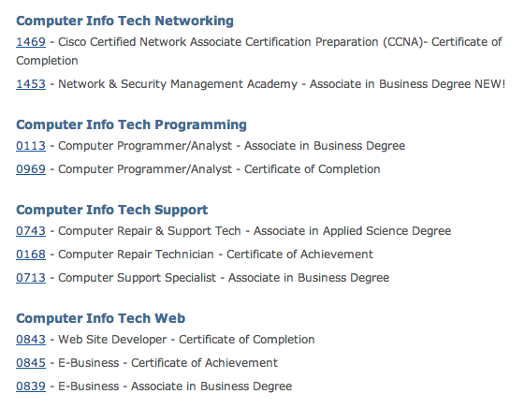
http://www.lcc.edu/cit/curriculum/
Notes:
There are four more “technology” majors.

Slide 8
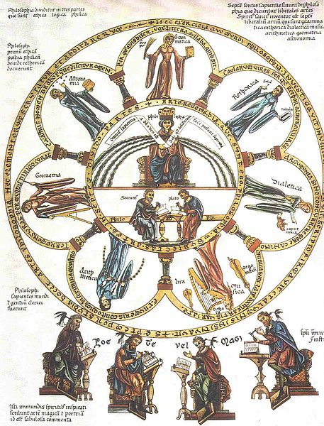
The liberal arts (Latin: artes liberales) are those subjects or skills that in classical antiquity were considered essential for a free person (a citizen) to know in order to take an active part in civic life
http://en.wikipedia.org/wiki/Liberal_arts_education
Notes:
I propose something different... Something that is essential to be a “free” (as in freedom) citizen. Being skilled and informed is essential to being a free citizen.

Slide 9
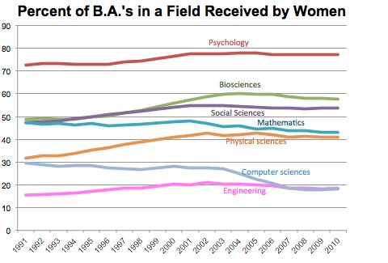
http://economix.blogs.nytimes.com/2013/11/15/women-gain-in-some-stem-fields-but-not-computer-science

Slide 10
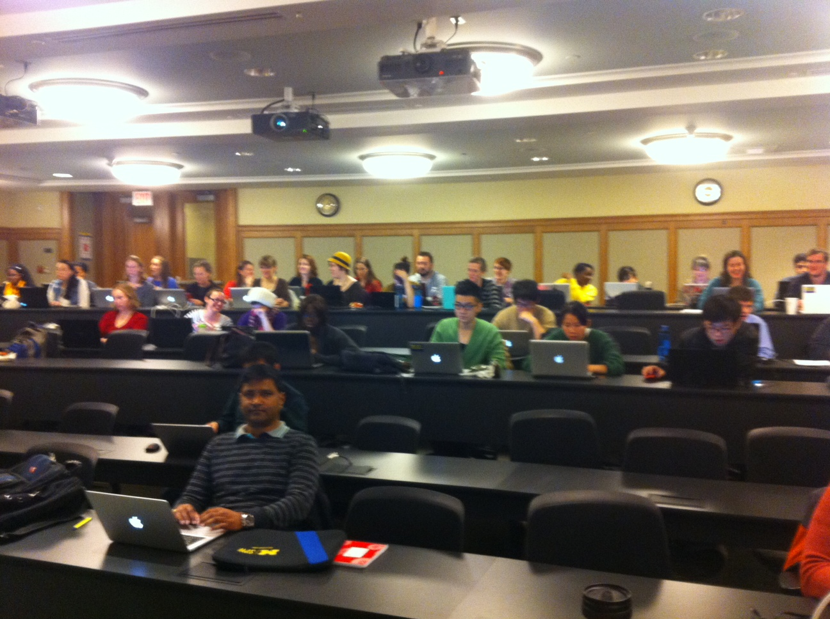
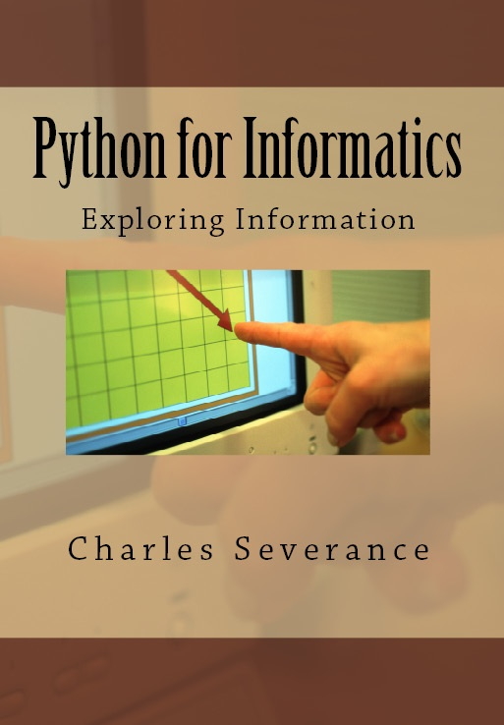
SI502 – Network Computing

Slide 11
WHAT NEXT?

Slide 12
WHAT DO YOU WANT ME TO DO NEXT?
http://www.youtube.com/watch?v=y39D4529FM4

Slide 13
Programs for Humans
while music is playing:
Left hand out and up
Right hand out and up
Flip Left hand
Flip Right hand
Left hand to right shoulder
Right hand to left shoulder
Left hand to back of head
Right ham to back of head
Left hand to right hit
Right hand to left hit
Left hand on left bottom
Right hand on right bottom
Wiggle
Wiggle
Jump
http://www.youtube.com/watch?v=vlzwuFkn88U
http://www.youtube.com/watch?v=sN62PAKoBfE

Slide 14
Errors in Programs for Humans
while music is playing:
Left hand out and up
Right hand out and up
Flip Left hand
Flip Right hand
Left hand to right shoulder
Right hand to left shoulder
Left hand to back of head
Right ham to back of head
Left hand to right hit
Right hand to left hit
Left hand on left bottom
Right hand on right bottom
Wiggle
Wiggle
Jump
http://www.youtube.com/watch?v=vlzwuFkn88U
http://www.youtube.com/watch?v=sN62PAKoBfE

Slide 15
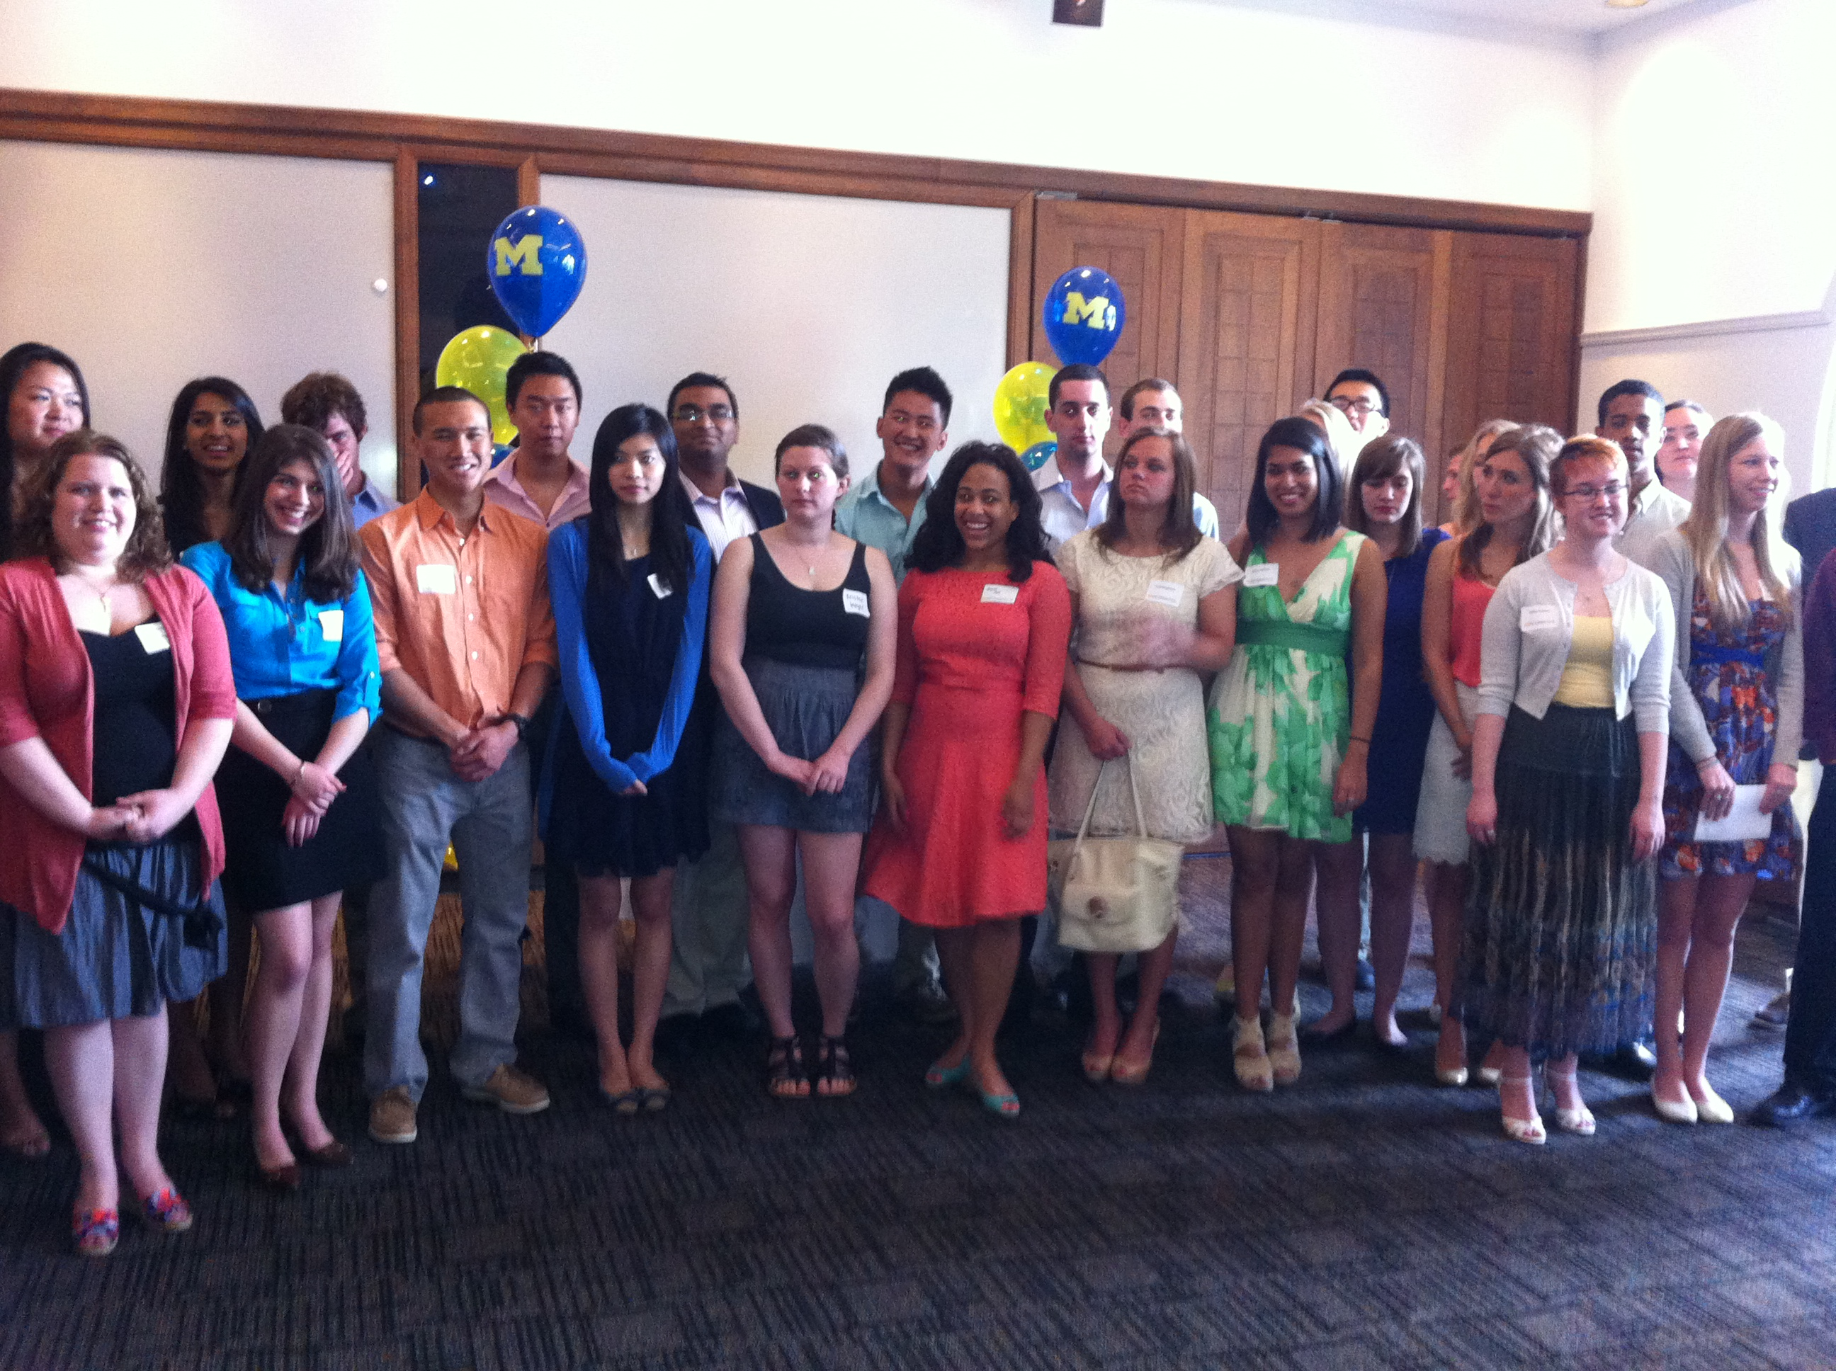
University of Michigan Informatics Graduation Reception – April 2013

Slide 16
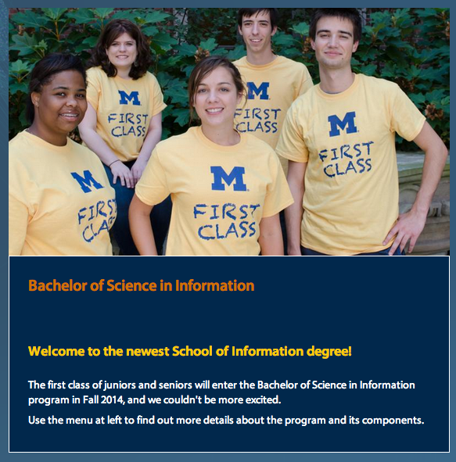

Slide 17
I would like to teach the World to think Computationally.

Slide 19
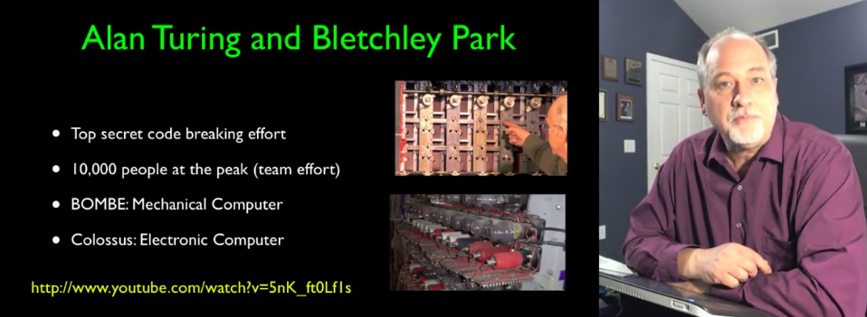

Slide 20
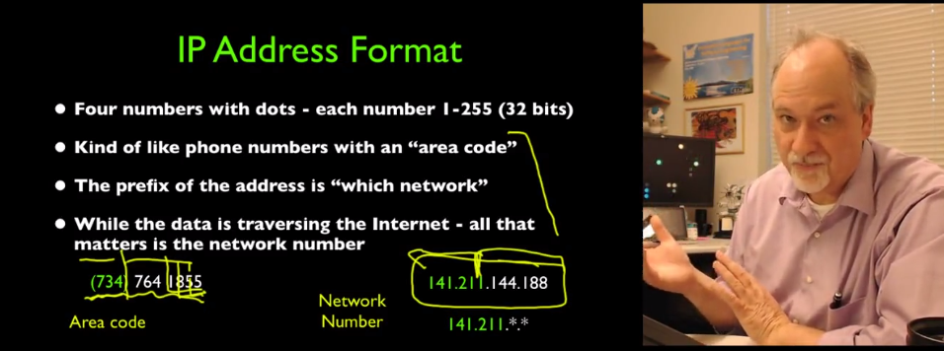
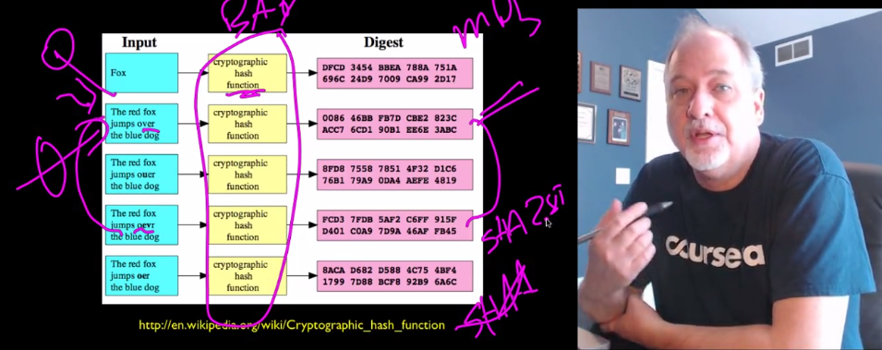

Slide 21
N=4701
http://www.dr-chuck.com/coursera/insidetheinternet/2012-001/maps/where.html

Slide 22
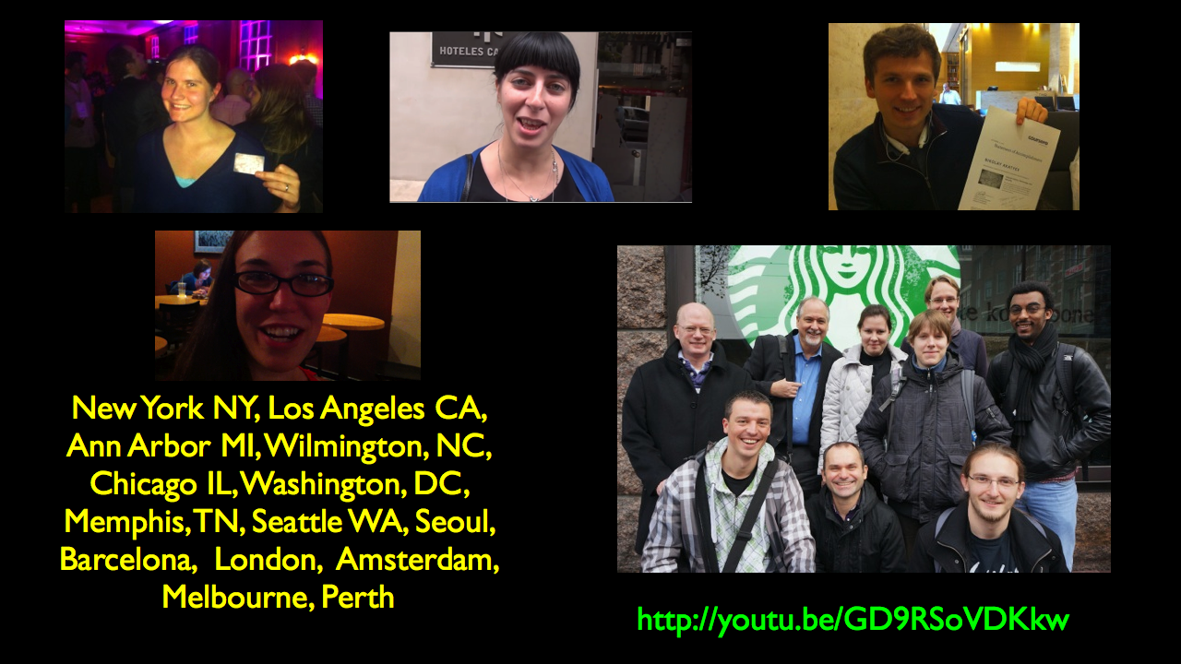

Slide 23
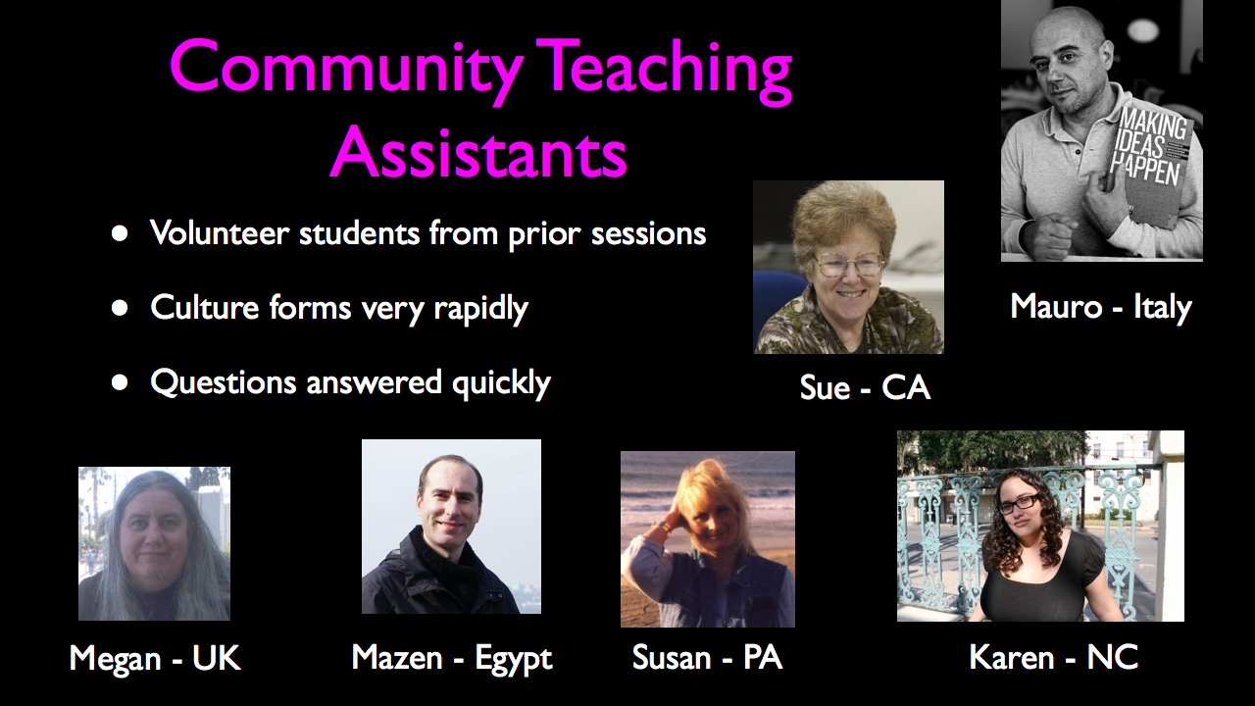

Slide 24
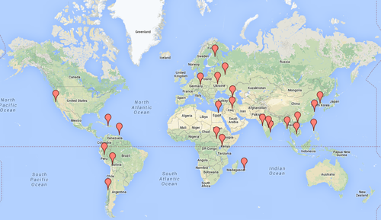
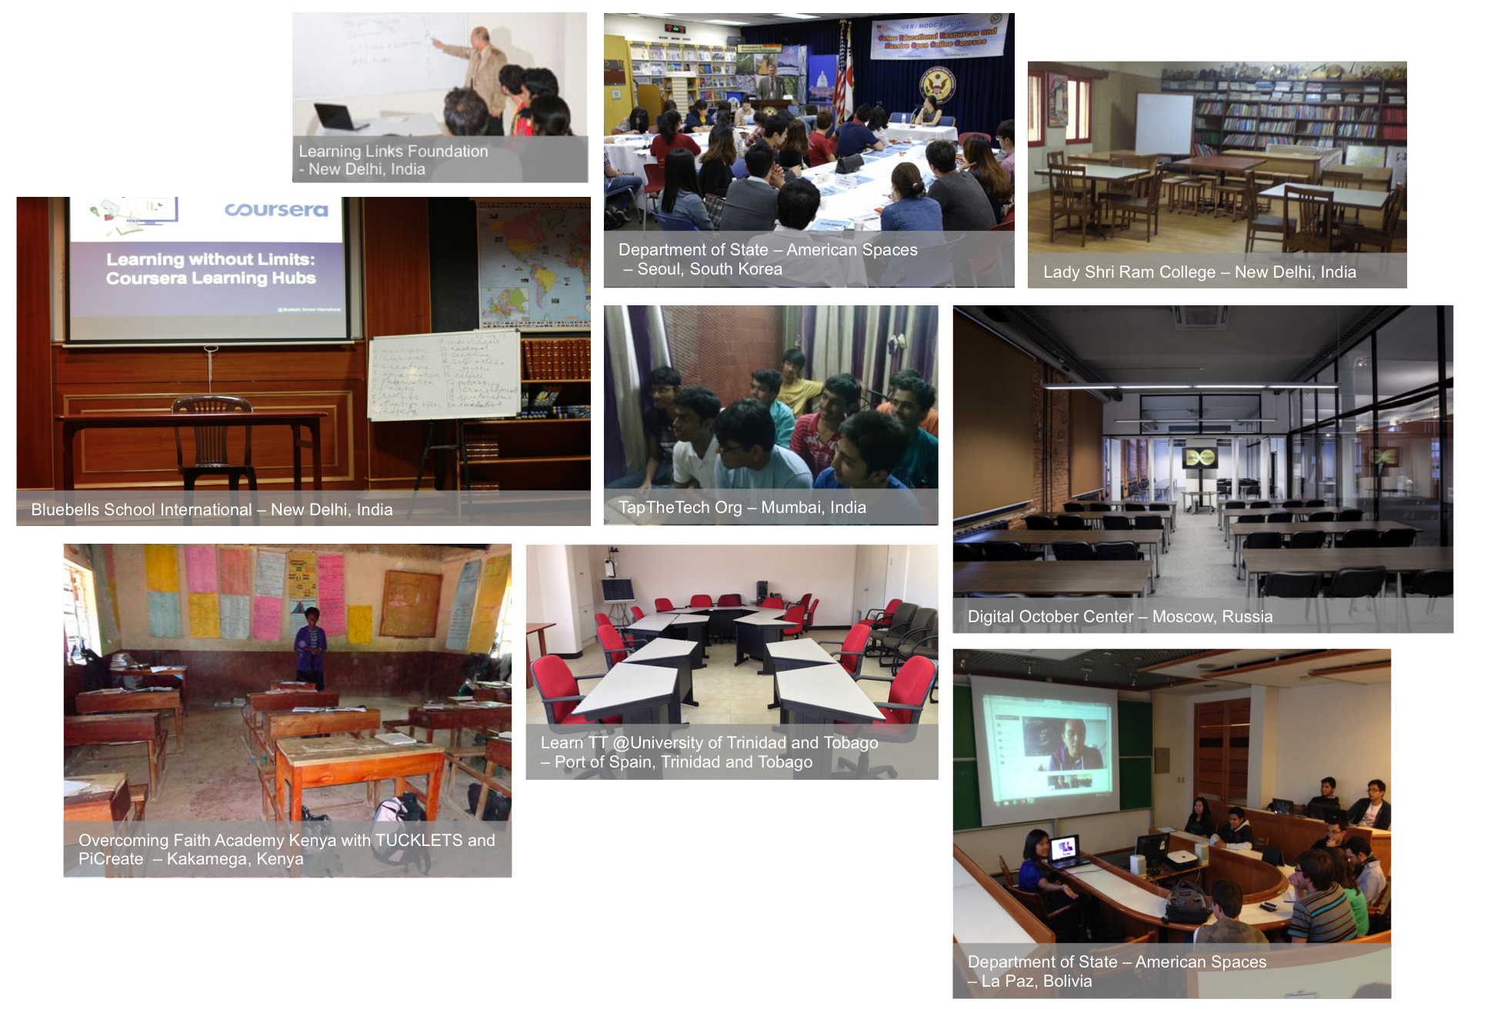
Learning Hubs
http://blog.coursera.org/post/65596539008/introducing-coursera-learning-hubs-global

